Slide 1
Energy forcasting
Advance Data Science - Assignment – 2

Slide 2
Work FLOW
www.wundergroundcom
Rawdata2.csv
Rawdata1.csv
Rawdata1.csv
Rawdata2.csv
www.wunderground.com
Feature Engineering
Model Selection
Linear Regression
Forward Search
Backward search
Stepwise (both ways)
Data Wrangling & Cleaning
Forcasting
Regularisation

Slide 3
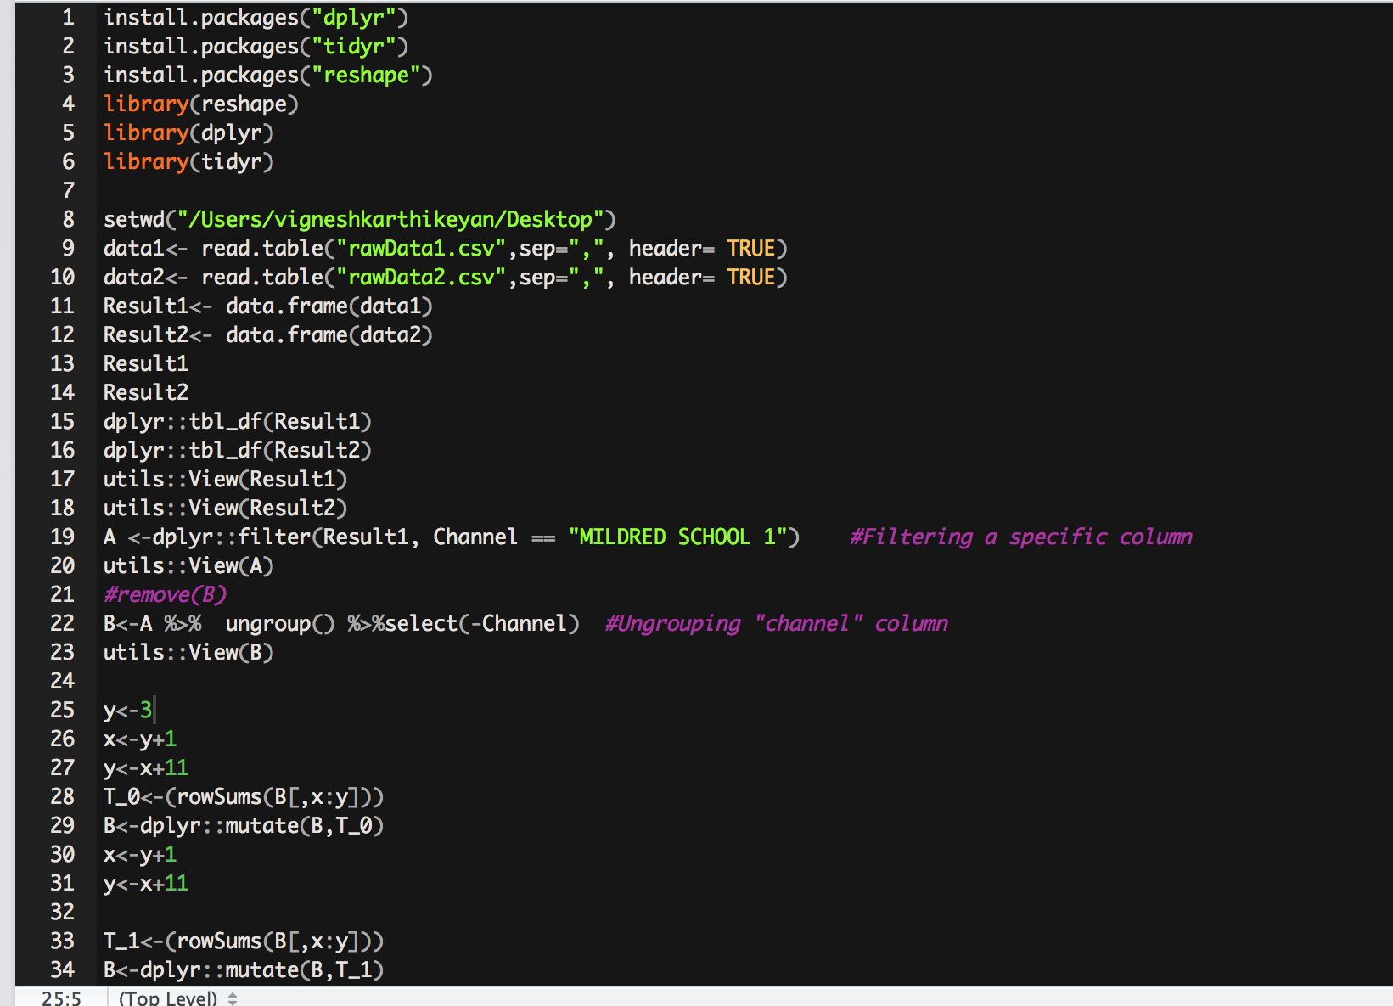
Code Snippets
Reading data from both the csv files
Converting data frame into tbl class
Filtering out the Mildred school data
Ungrouping channel column from the csv
We combine the columns for each hour for a total of 24 hours. We use the mutate function in dplyr to merge columns with 5 min time intervals into a single column for each hour.

Slide 4
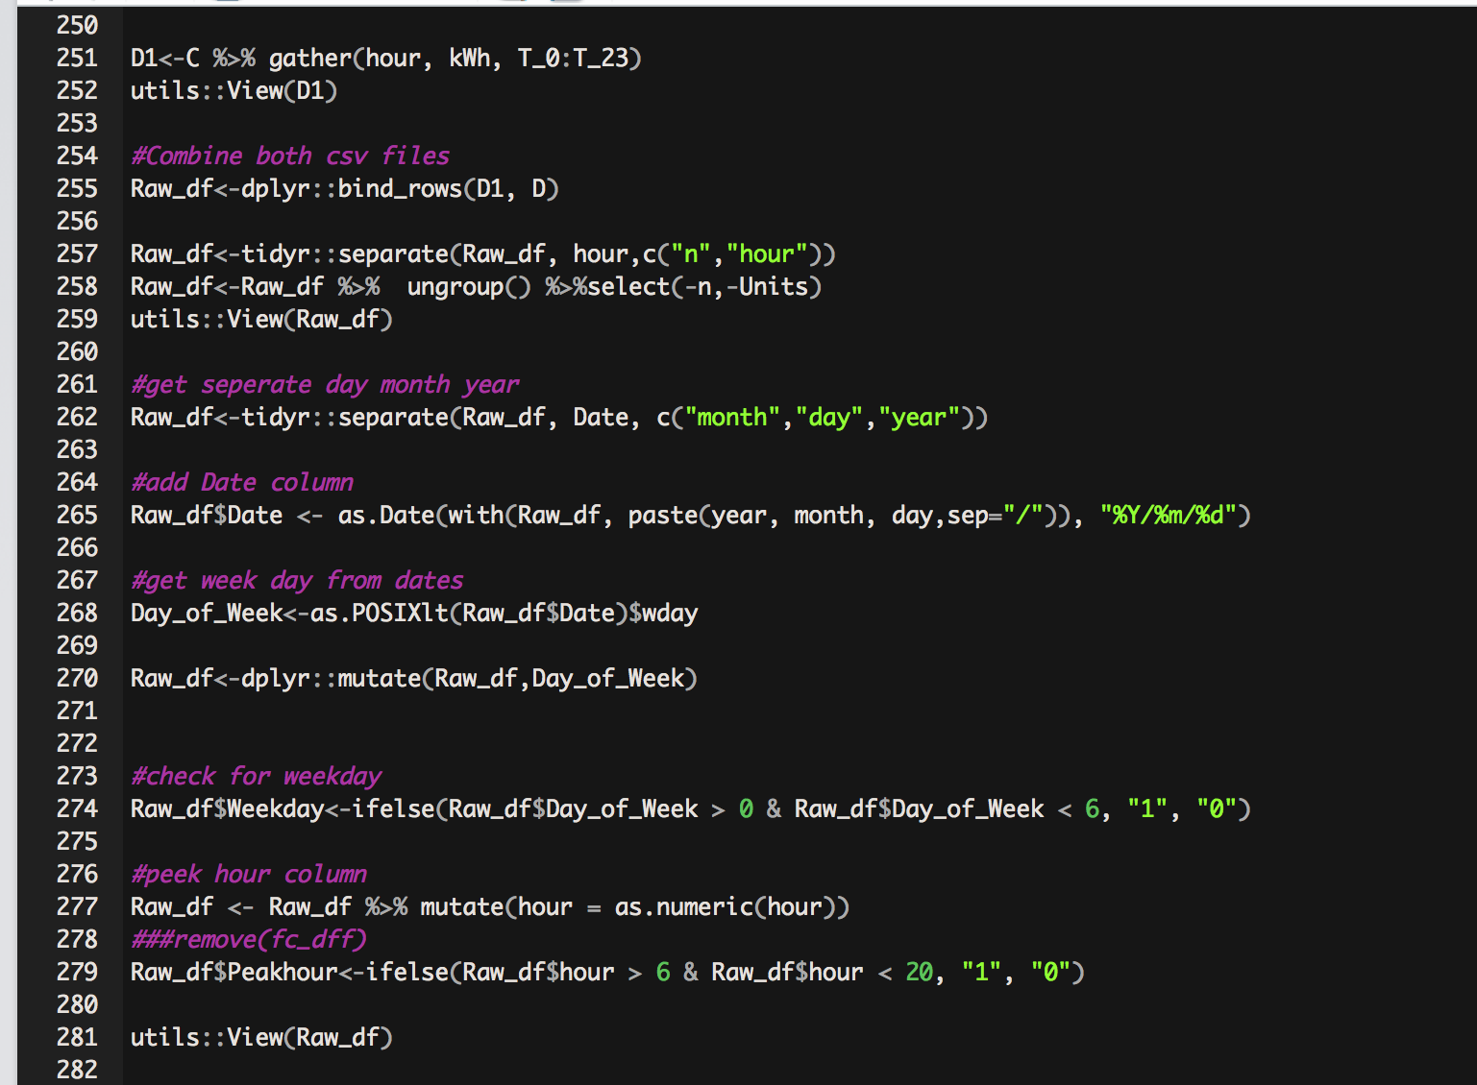
Combine both csv files
Separate T_0 to T and 0 to filter out hour
Cleaning the data according to specified requirements

Slide 5
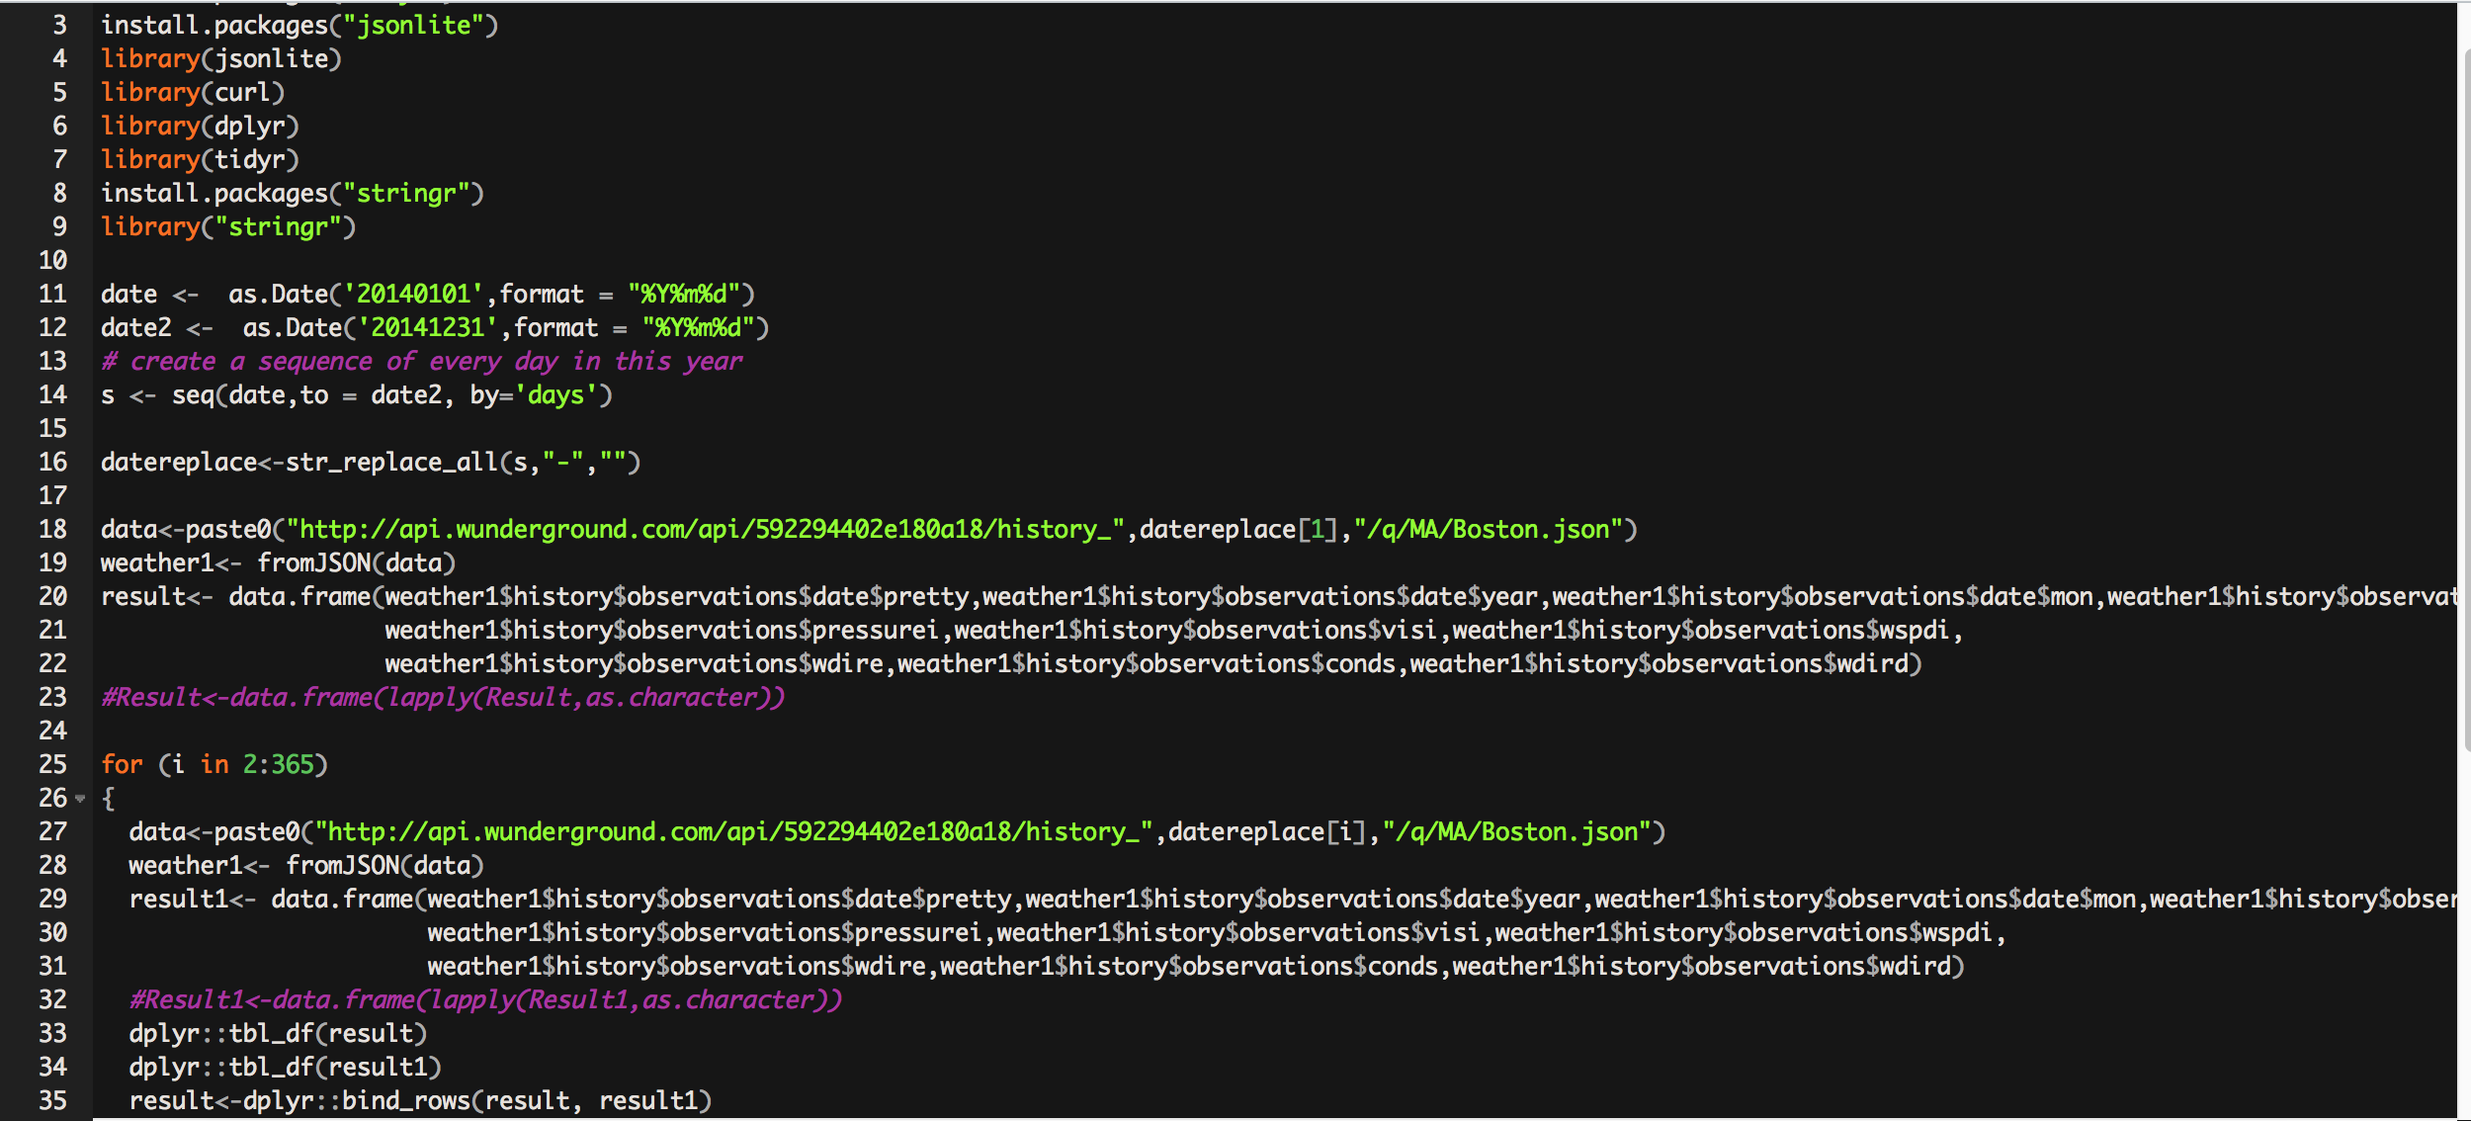
Creating a date sequence
Traversing through all days of the year ‘2014’ and getting the required data from the api

Slide 6
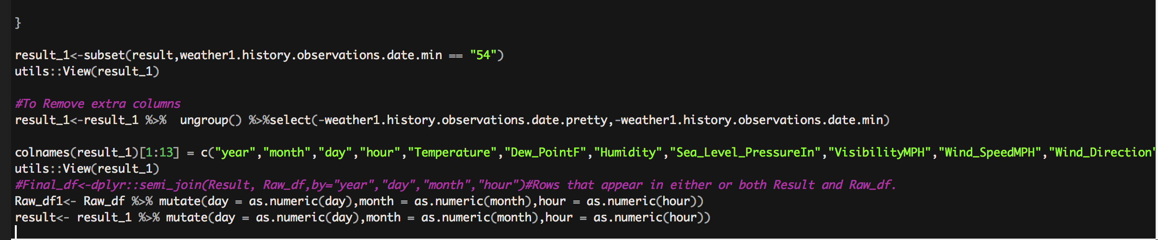
To remove the extra columns
Converting into numeric

Slide 7
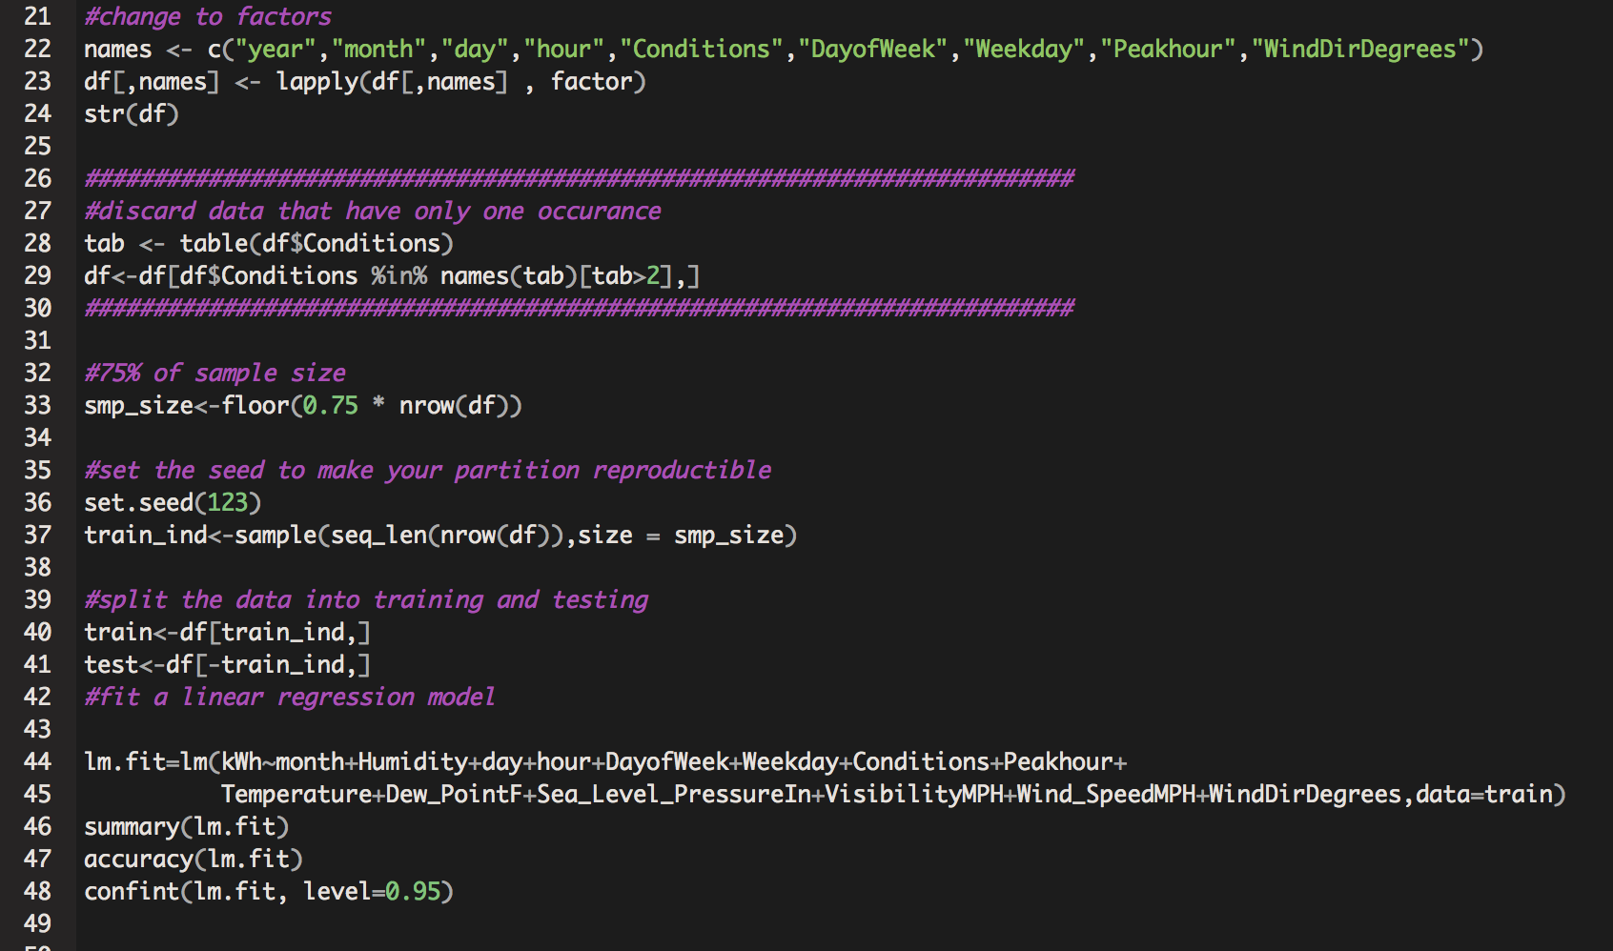
LINEAR REGRESSION

Slide 8
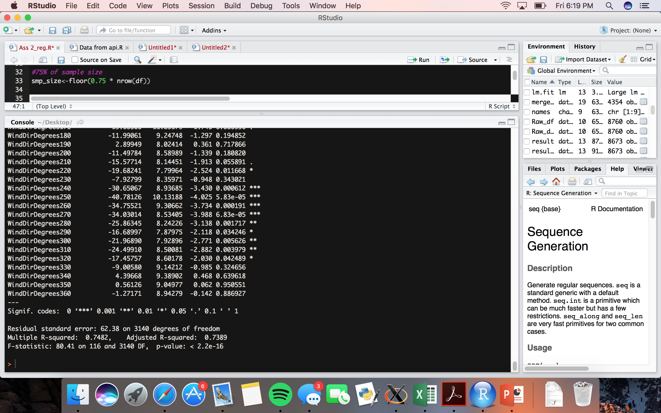
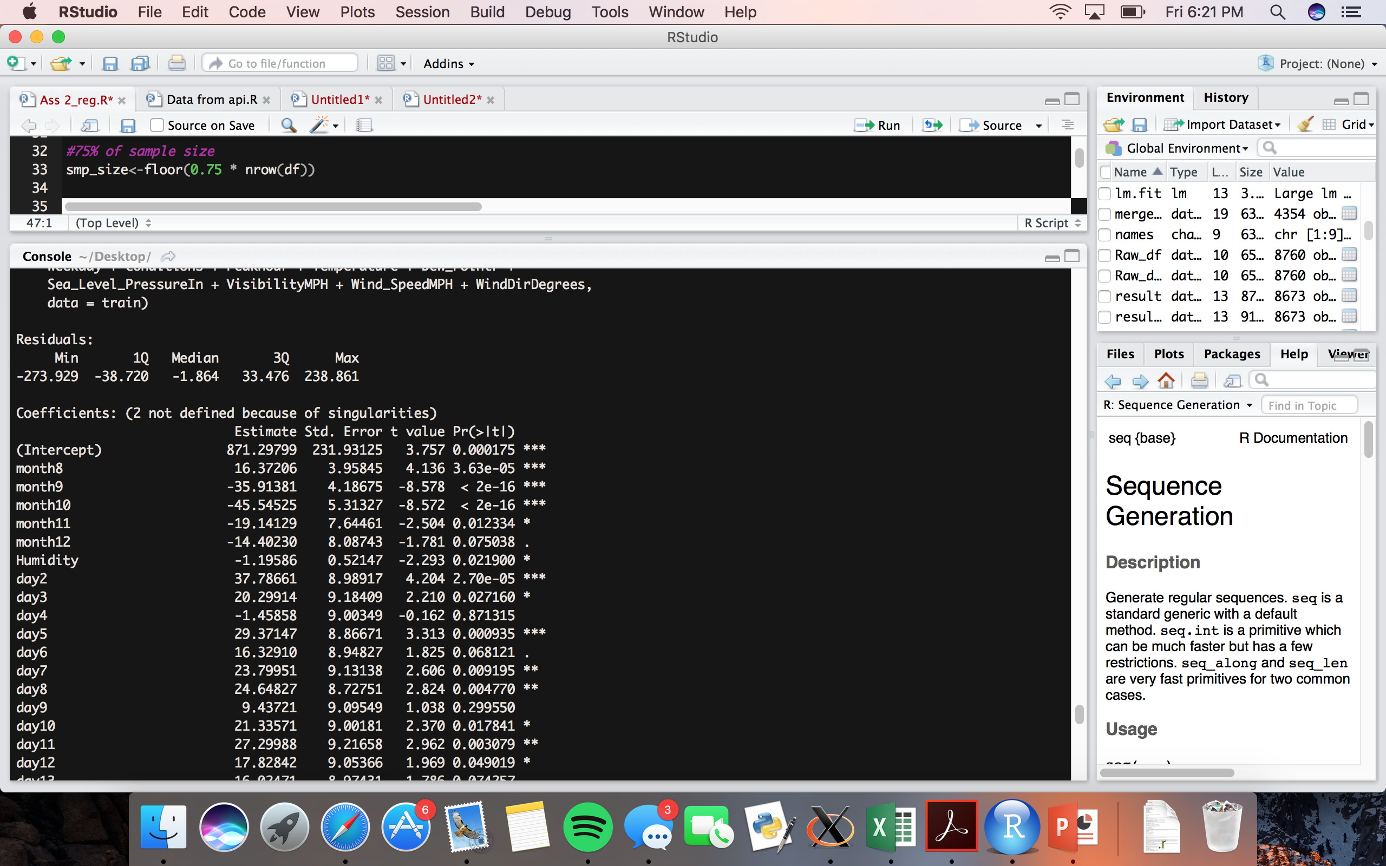
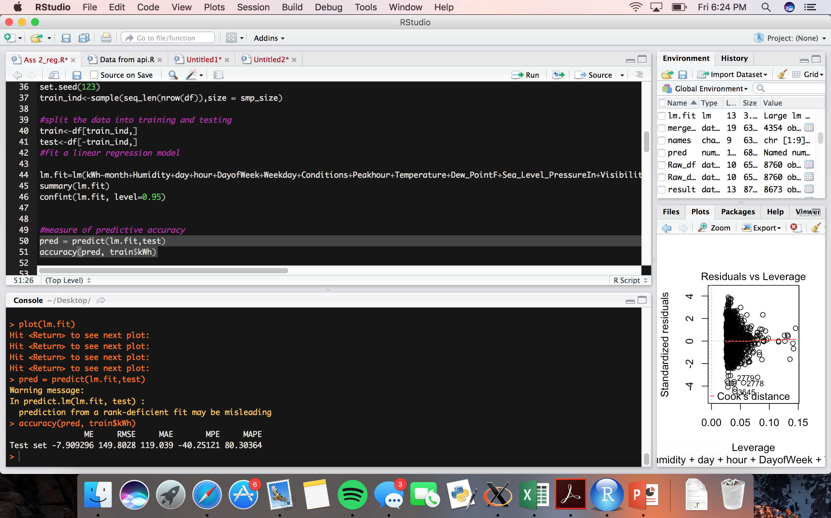
OUTPUT FOR LINEAR REGRESSION
ADJUSTED R-SQUARED
ACCURACY PREDICTION

Slide 9
GRAPHS

Slide 10
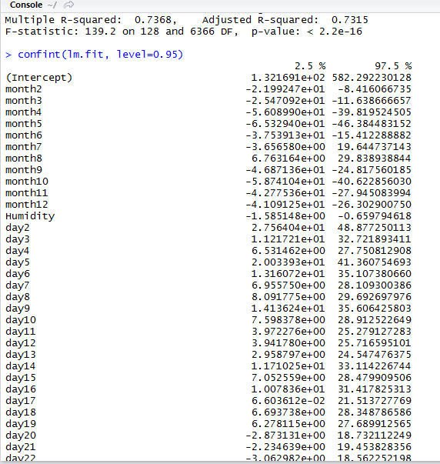
Confidence Interval for linear Regression

Slide 11
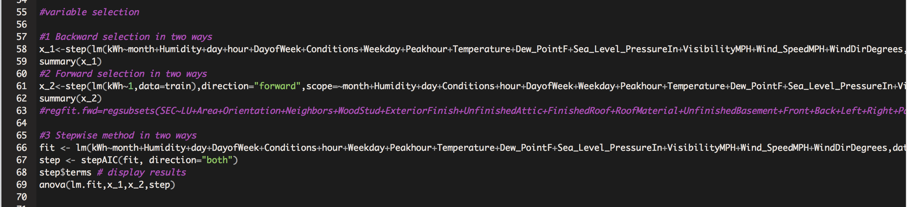
VARIABLE SELECTION

Slide 12
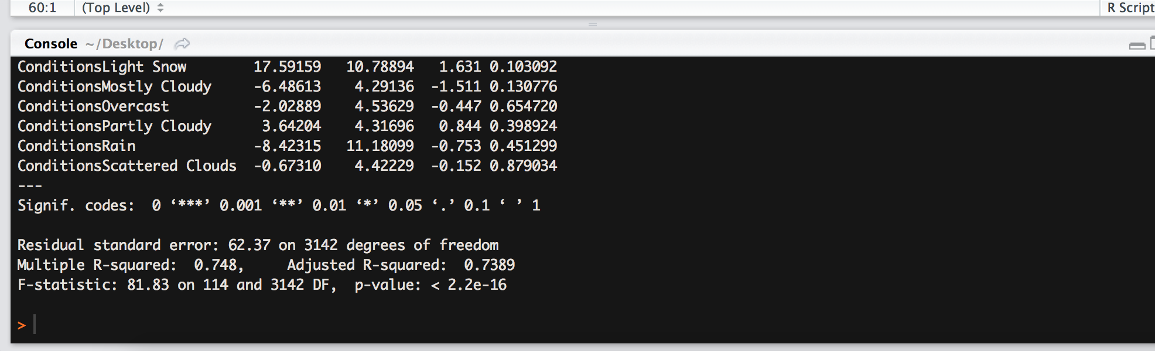
FOREWARD SEARCH

Slide 13
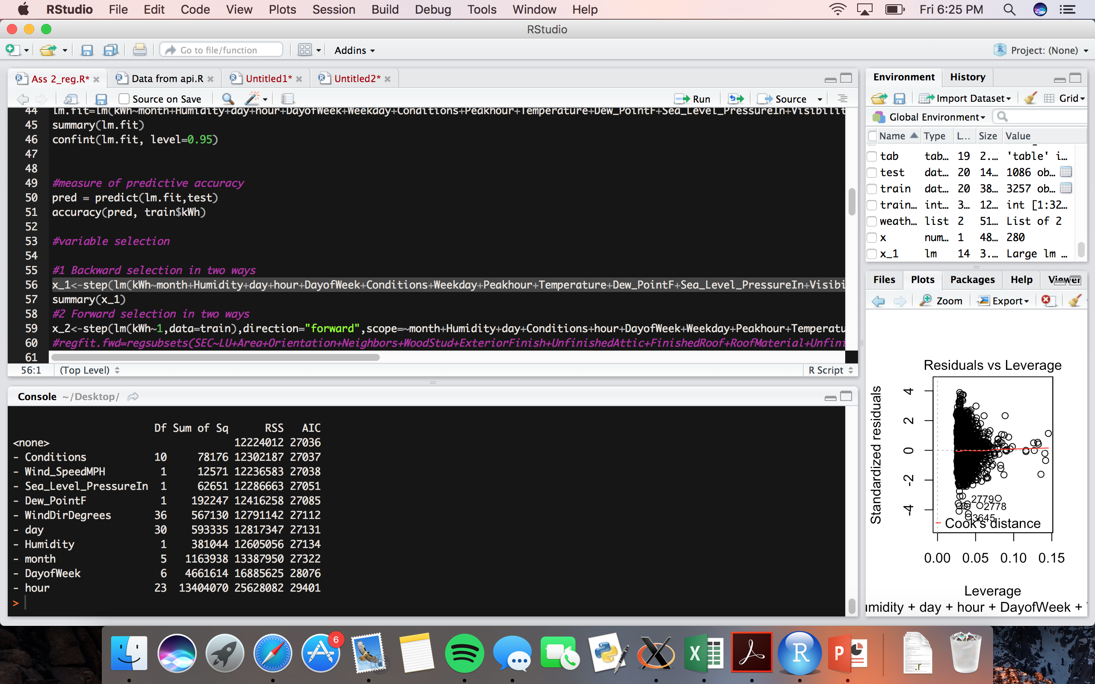
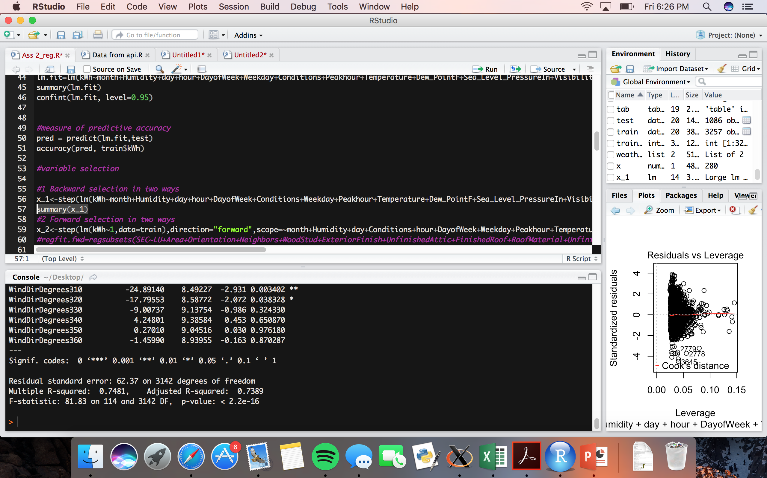
BACKWARD SELECTION

Slide 14
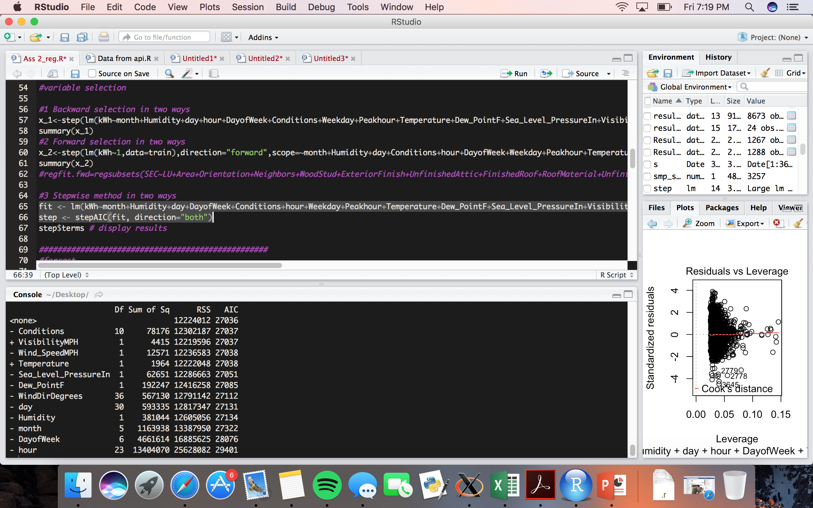
Stepwise Regression Both ways

Slide 15
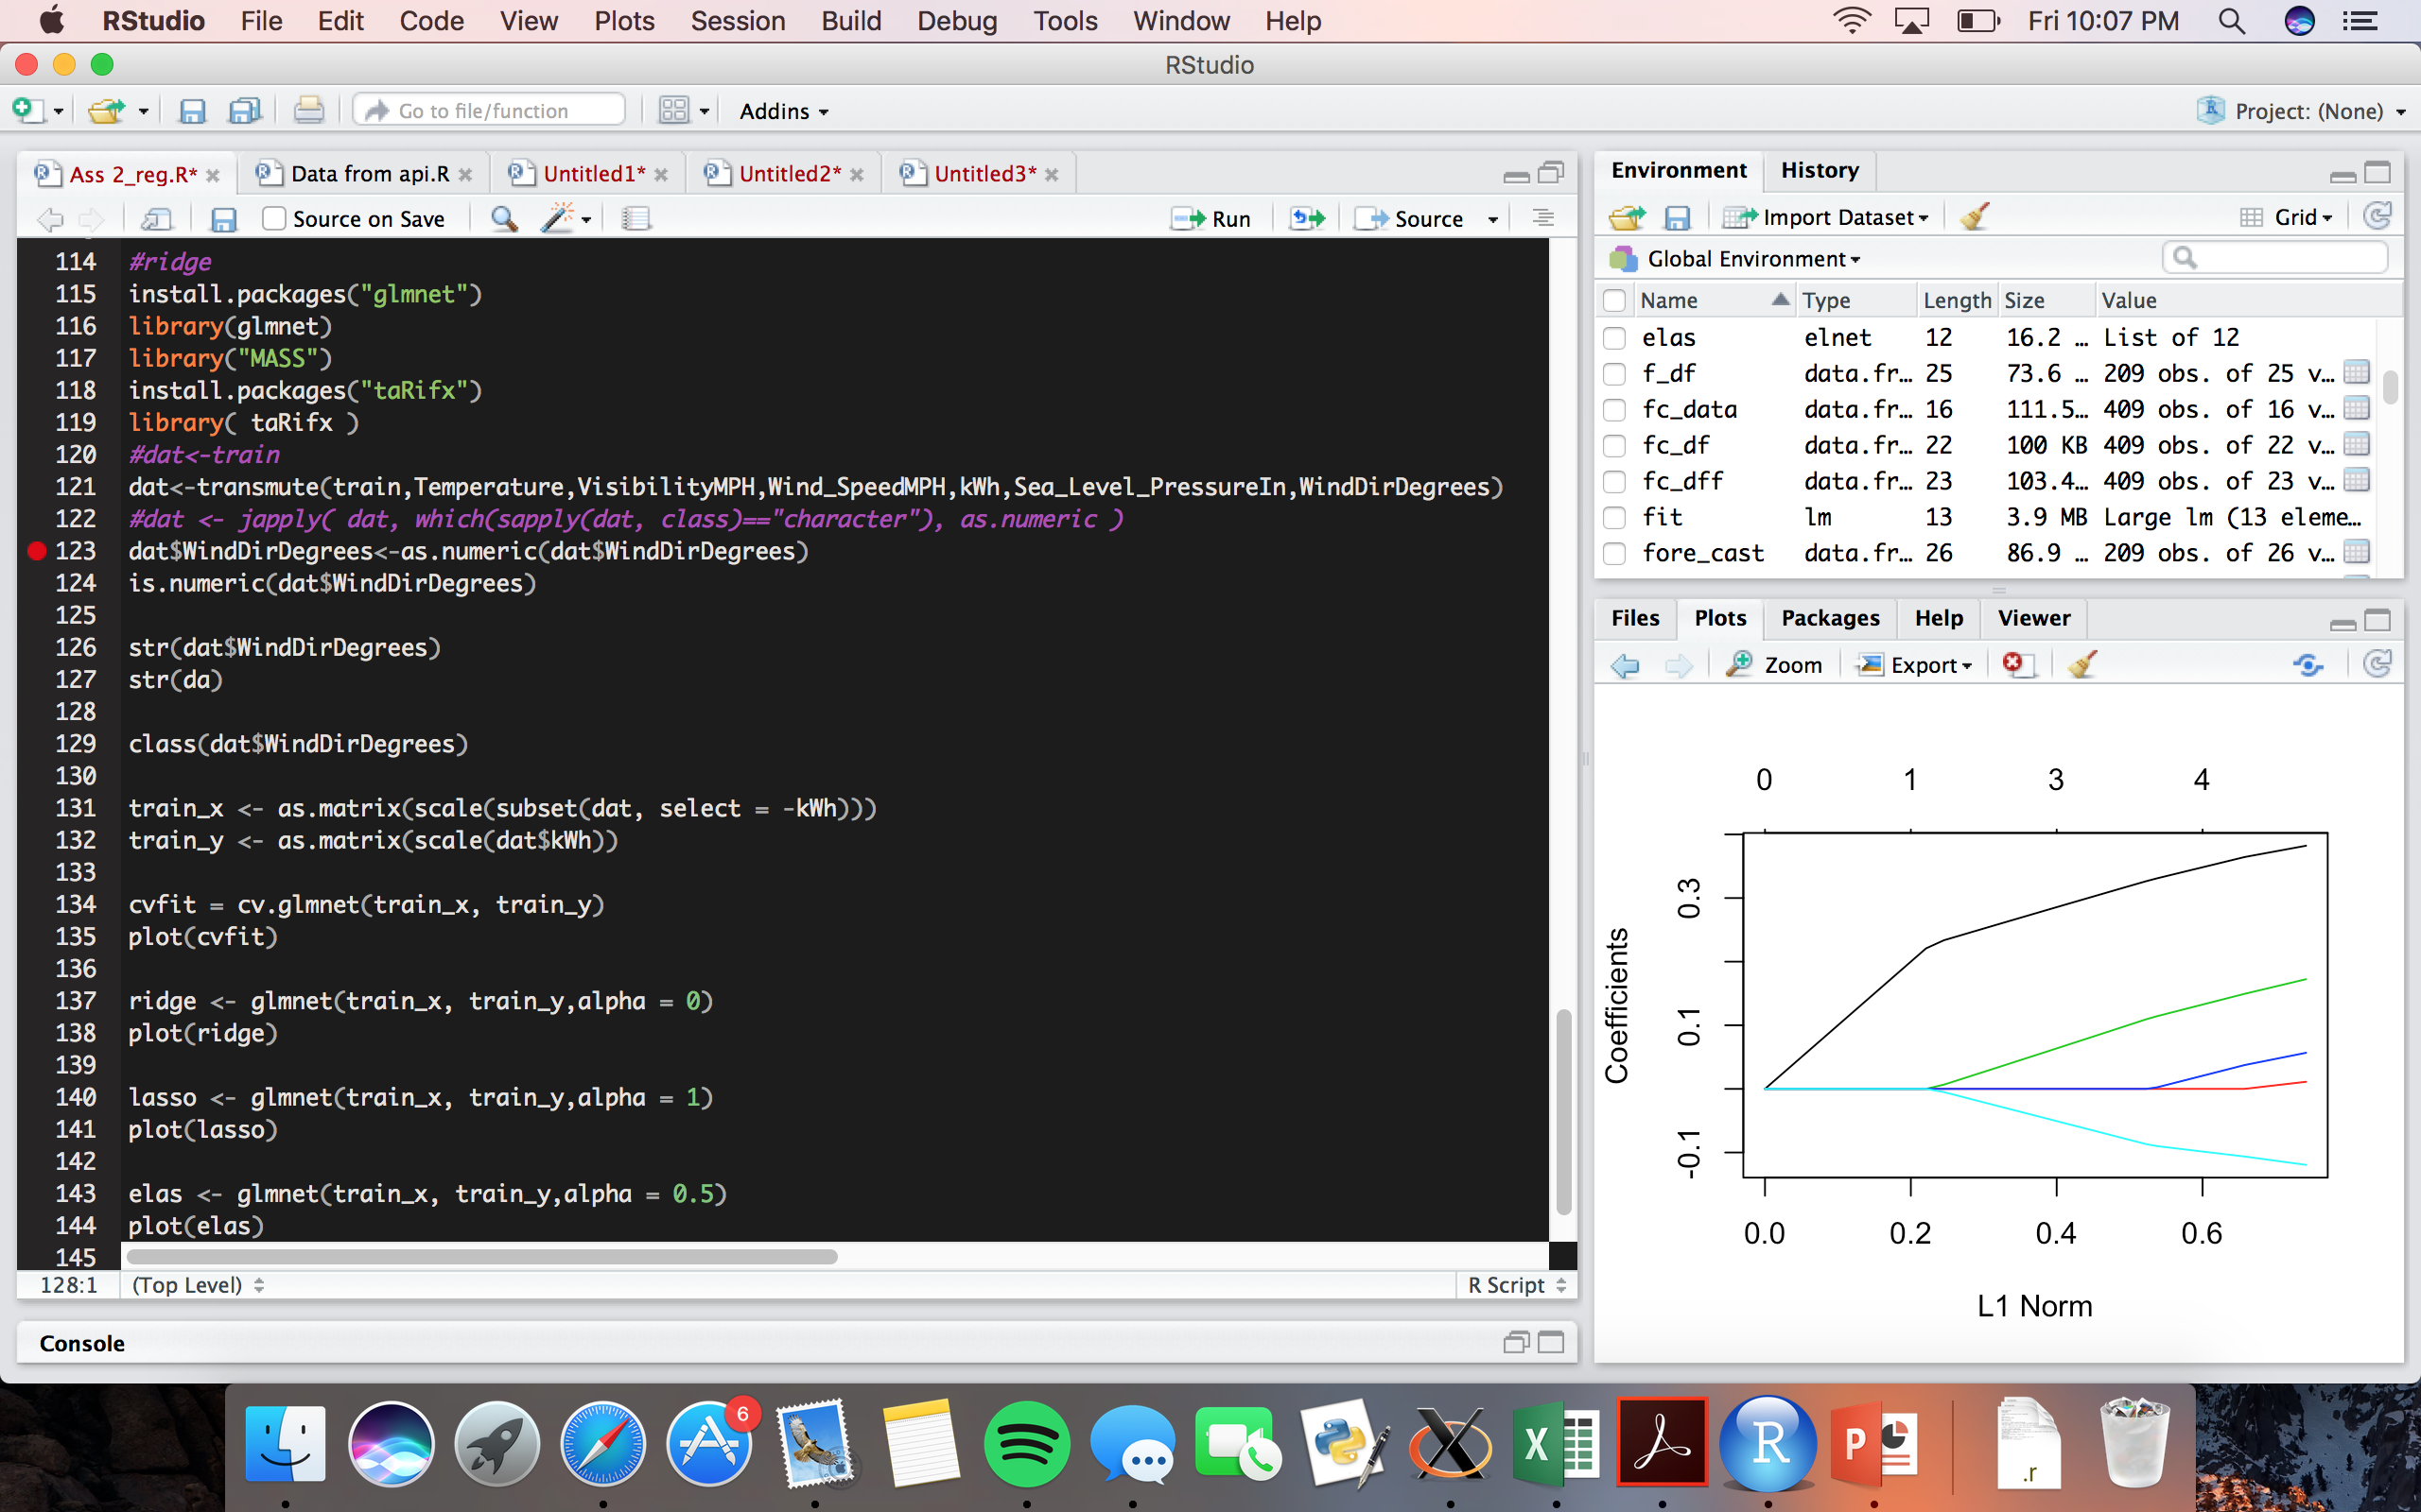
REgularisation

Slide 16
Plot for ridge : Lasso : Elastic
Ridge Regression
⍺ = 0
Lasso Regression
⍺ = 1
Ridge Regression
⍺ = 0.5

Slide 17
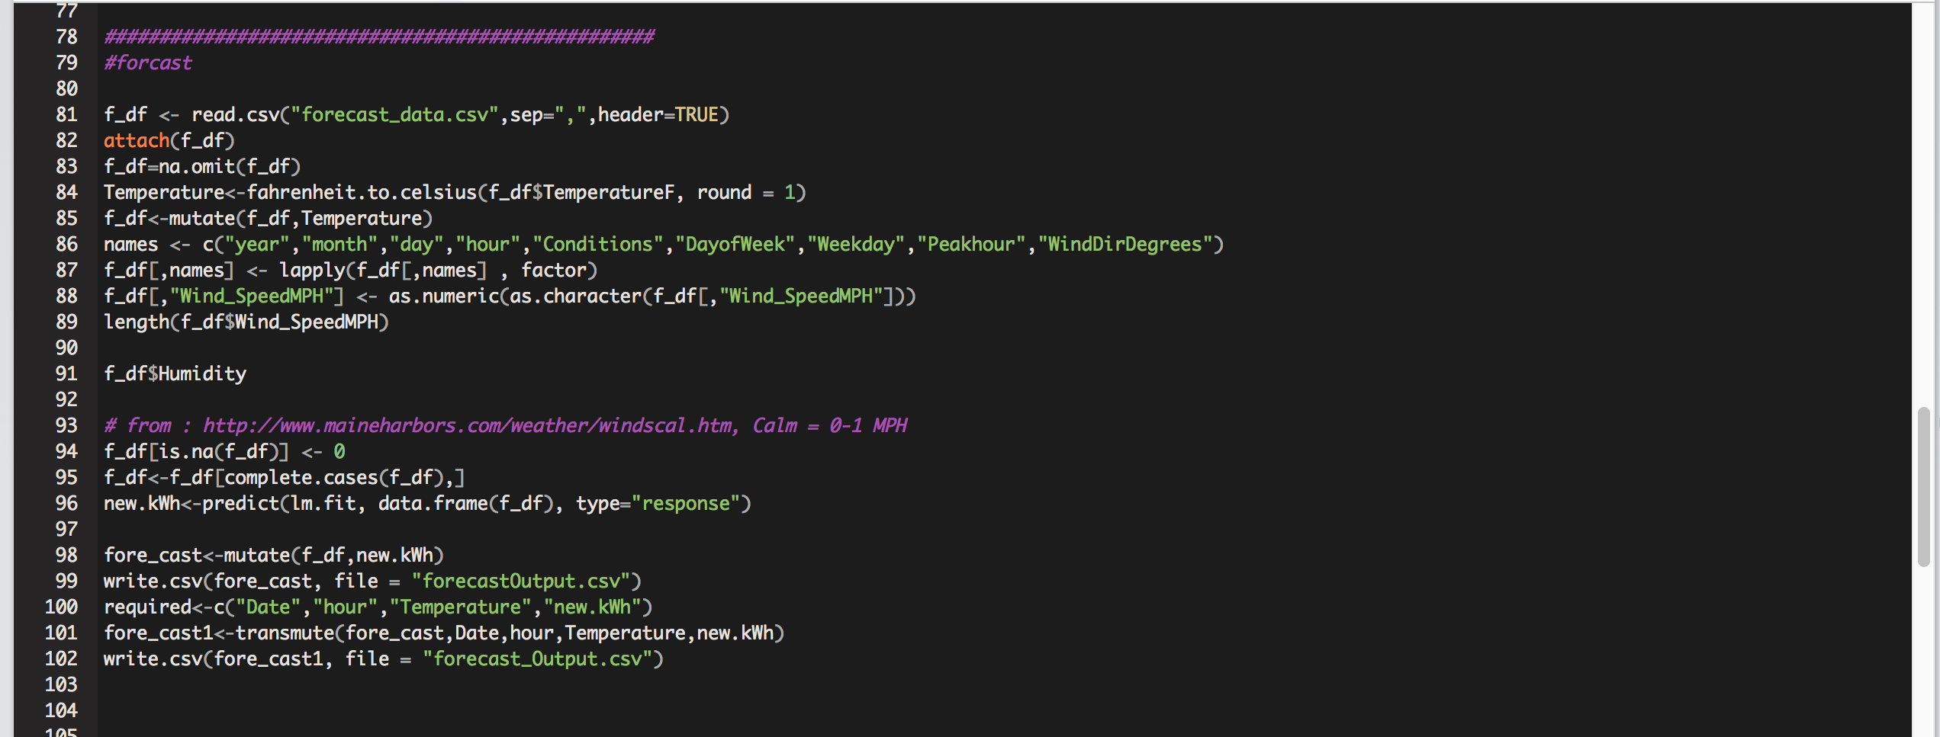
Forecasting

Slide 18
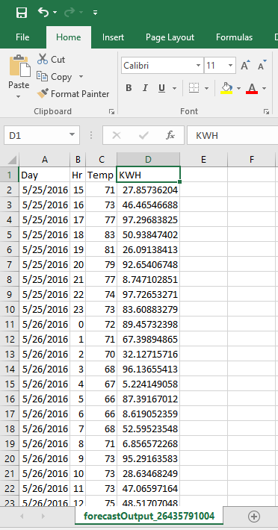
Forcasting Output

Slide 19
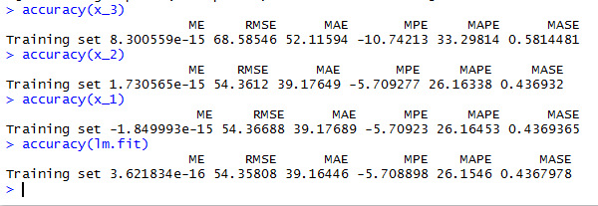
Performance Metrics

Slide 20
Thank You
Team 8 – Ankita Shanbhag , Sriniketan G.S. , Vignesh Karthikeyan

